Slide 1
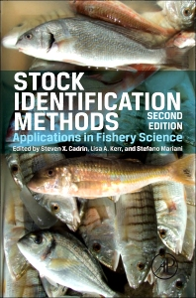
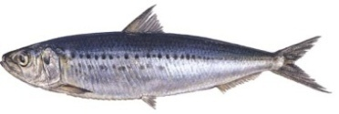
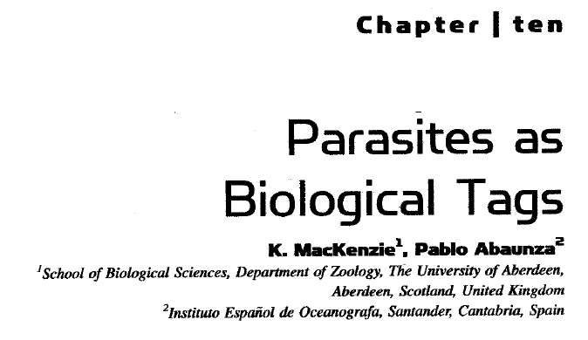
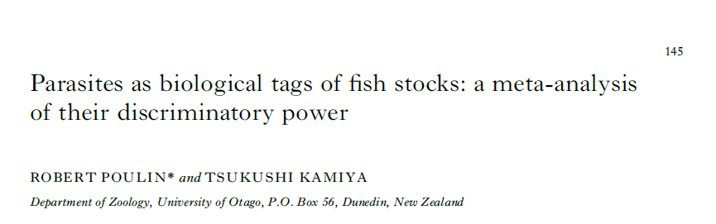
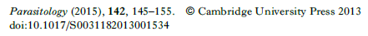
Using a parasite bio-tag to examine population structure of SA sardine
CD van der Lingen
Offshore Resource Research, DAFF; and Marine Research Institute, Department of Biological Sciences, UCT
Parasite bio-tagging one of several stock identification methods used in fish population structure studies; underpinned by decay in similarity of the parasite species assemblage as a function of increasing distance between hosts
Widely-used and well-developed approach, criteria for biotag selection, etc
Meta-analysis reports overall probability of correct classification of fish based on parasite data of 71%

Slide 2
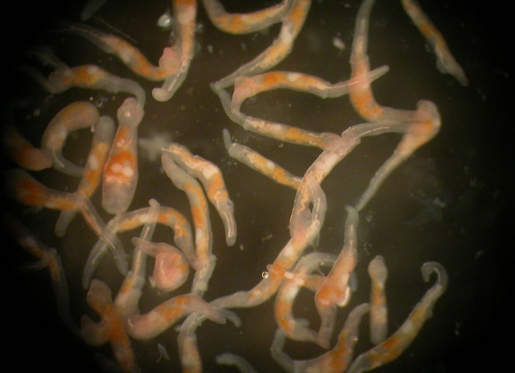
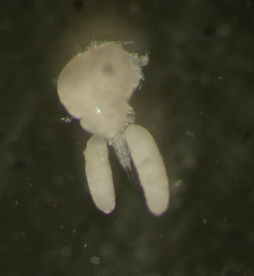
Parasites as bio-tags (i):
Main principle: hosts can only become infected within the parasite endemic area (region within which conditions are suitable for parasite transmission, and determined by existence of suitable environmental conditions and the presence of all required host species for different stages in the parasite life cycle)
Infected fish found outside the endemic area must have been within the endemic area at some time in the past; individual fish carry “parasitological fingerprints” that enable tracing of past movements; duration of fingerprint viability depends on parasite life span
Small number of parasite biotags selected following initial survey of parasite assemblage (spatial difference in infection levels, endoparasitic, site-specificity, easy detection and identification) and large number of host individuals examined for selected parasites (prevalence, infection intensity and abundance)
Entire parasite assemblage documented and analysed using more advanced statistics (discriminant analysis, cluster analysis); particularly applicable to host species not available in large numbers

Slide 3
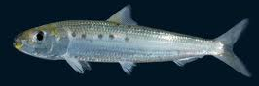
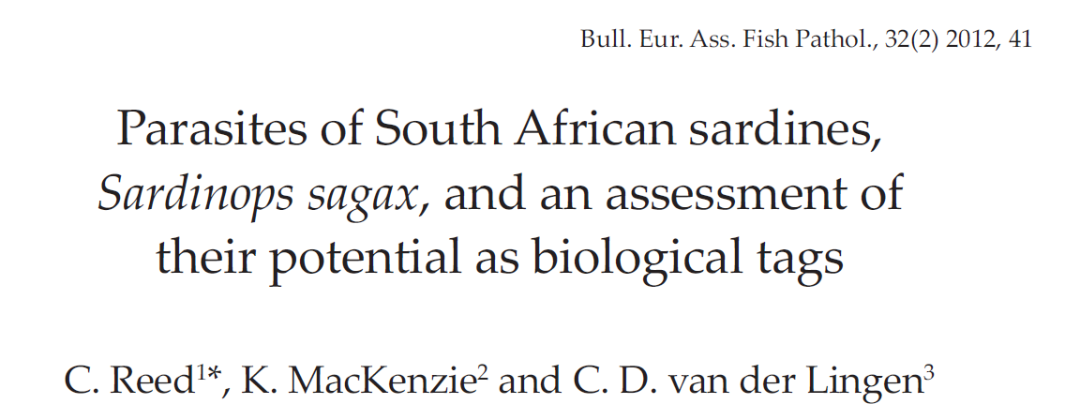
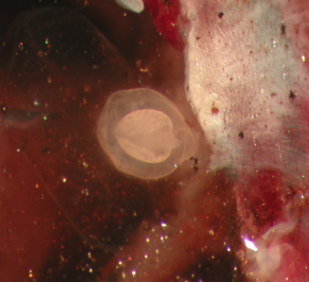
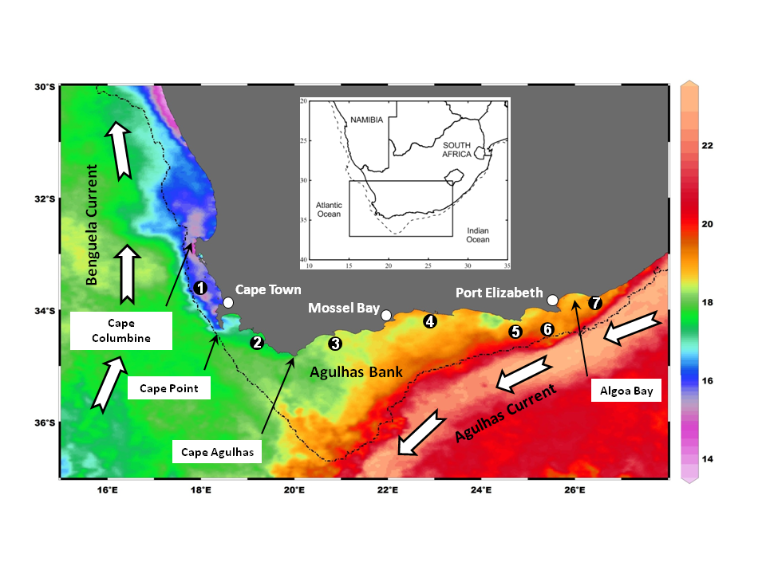
Application to SA sardine (i):
Parasite biotag approach applied to SA sardine (part of a multi-method approach including morphometrics, meristics, genetics, biological characteristics)
Assess parasite assemblage and identify biotags:
102 sardine from 7 sites around SA coast examined
7 parasite taxa, 3 new host records
Digenean “tetracotyle” type metacercariae (TTM) found in sardine eyes showed greatest biotag potential (spatial variability in prevalence, endoparasite, other criteria)
Process sardine for TTM
% prevalence
60
0
78
20
33
20
93
Reed et al (2012)

Slide 4
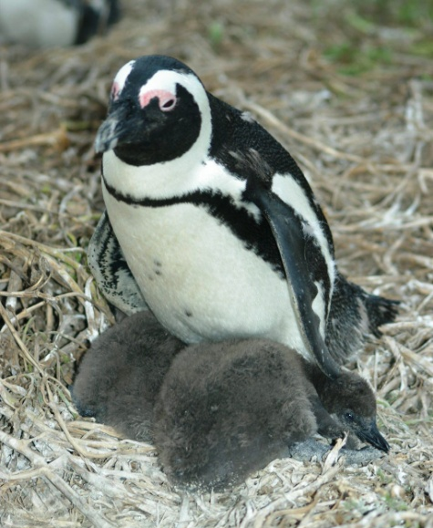
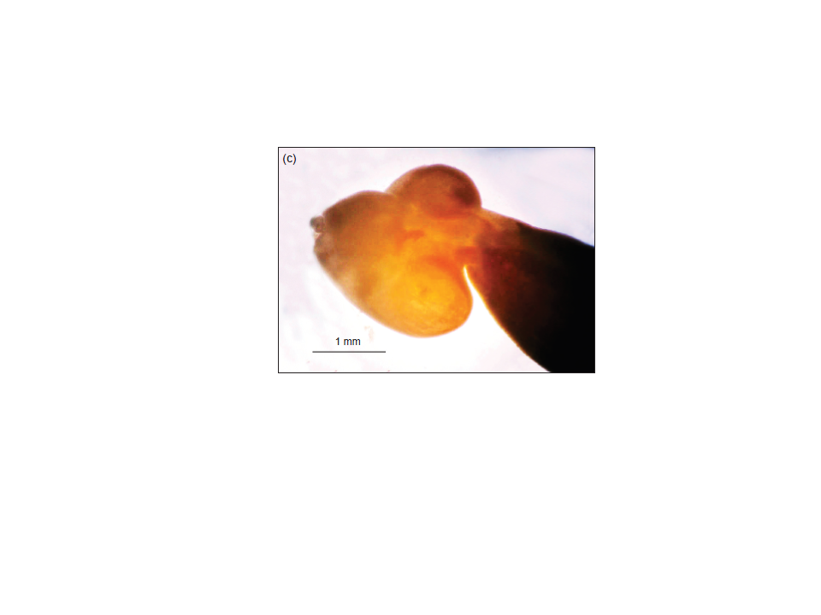
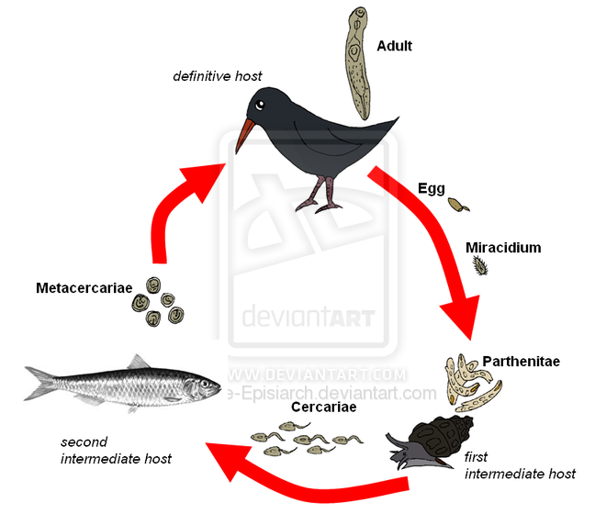
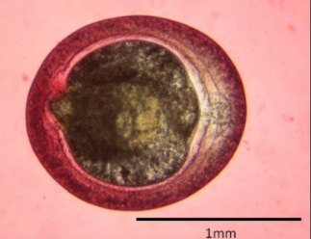
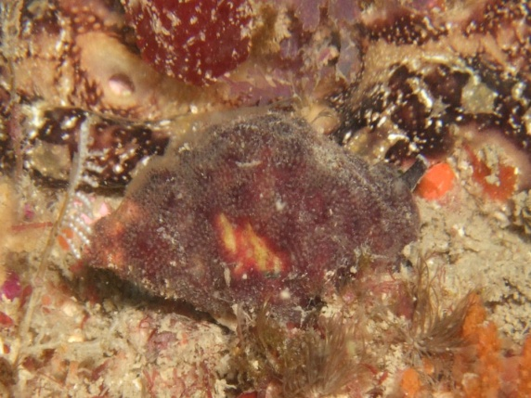
Application to SA sardine (ii):
“Tetracotyle” considered to be Cardiocephaloides physalis (biotag used in stock identification of Argentinian anchovy)
Life-cycle of these digenean parasites includes a gastropod 1st intermediate host, a fish (sardine) 2nd intermediate host and a seabird definitive host (no fish-to-fish transmission)
Horne et al (2011)
African penguin host to adult C. physalis
1st intermediate host unknown: hypothesized Burnapaena papyracea, abundant subtidal gastropod distributed from Cape Agulhas to Luderitz (W coast endemic area)

Slide 5
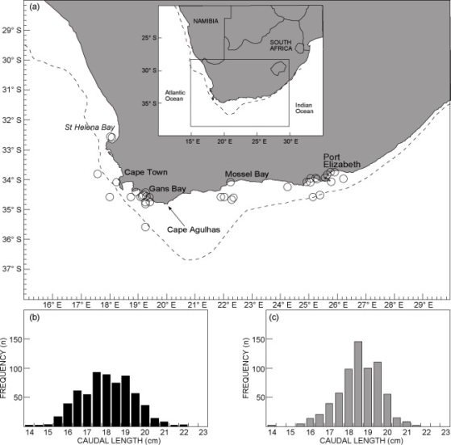
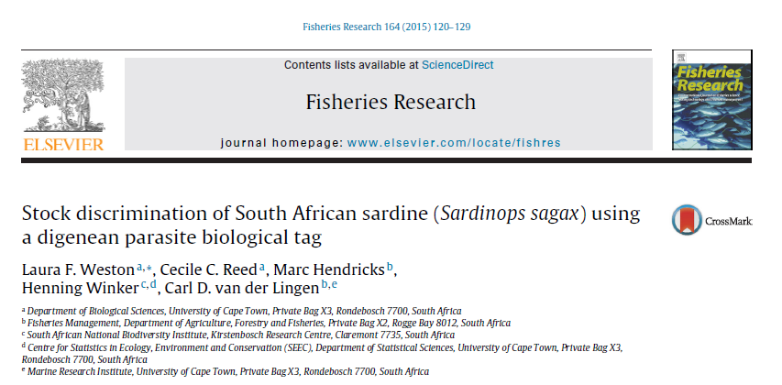
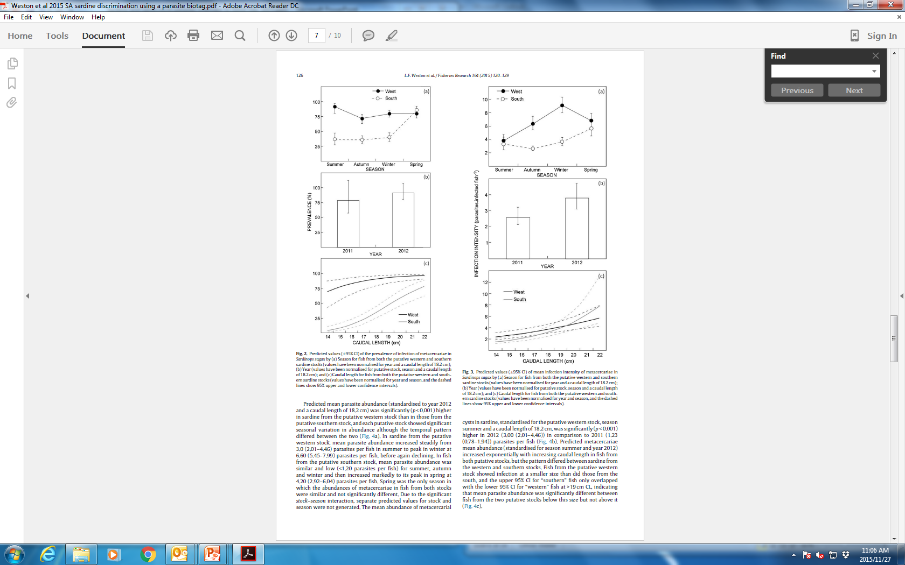
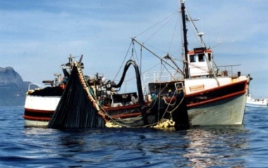
Application to SA sardine – commercial catch samples (i):
1 318 sardine from commercial catch samples in 2011 and 2012 examined (641 and 677 from putative western and southern stocks, respectively)
GLMs used to assess effects of Stock, Year, Season and CL on 3 indices of infection
Prevalence (pseudo-R² 0.21): log(CL), Stock, Year
Intensity (pseudo-R² 0.29): Stock, Season, Year
Abundance (pseudo-R² 0.30): Stock, log(CL), Year
Supports hypothesis of western and southern stocks

Slide 6
Application to SA sardine – ISAW 2013 and 2014
2013 Panel Report:
The biological studies and stock assessment model favour a two-stock sardine population scenario with movement of age-0 fish from the west stock to the south stock.
The data on presence of parasites by length should be included in the assessment as a “biologically-tagged” population component; potentially this could provide a bound for the average movement rate of age-0 animals from the west to the south stocks.
2014 Panel Report:
Alternative D (Varied Adult Movement). Fits to the parasite data should be used to evaluate the plausibility of the sub-variants of this model variant.
Alternative C (Varied Adult Distribution). Fits to the parasite data should be used to evaluate the plausibility of the sub-variants of this model variant.
Initial focus for model development should relate to including prevalence of the parasite, but the abundance (intensity) of the parasite may provide additional information and should be considered as a qualitative reality check if possible.
Continue collecting parasite data!

Slide 7
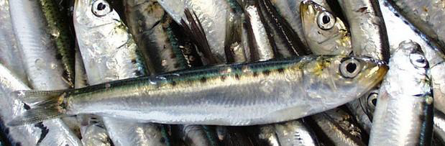
Application to SA sardine – commercial catch samples (ii):
Another 999 (2013) and 2 008 (2014) fish from commercial catches processed for TTM; 4 327 fish (2 206 from western and 2 121 from southern stock)
Stock most important for all 3 indices
Increasing infection with CL for western and southern fish (logistic model); suggests W to S movement of larger fish (not only 1-yr olds)
Alternative analysis (logistic to 18 cm CL, straight line thereafter) confirmed increased prevalence in >2 yr old southern fish
Ross-Gillespie and Butterworth (2014)

Slide 8
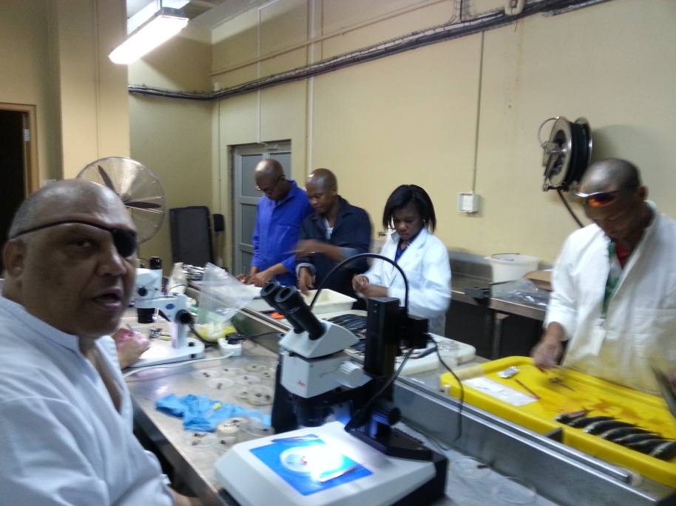
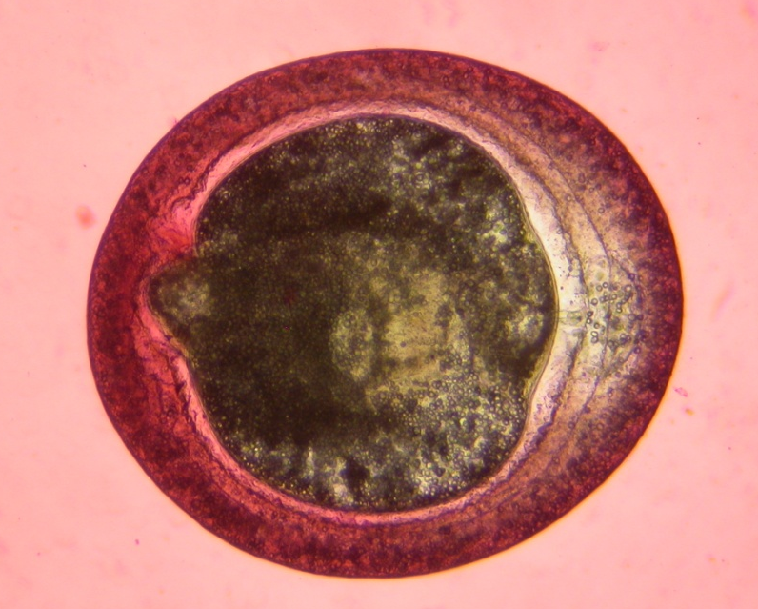
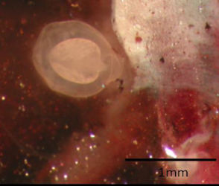
Application to SA sardine – research survey samples (i):
% Prevalence
~3 600 juvenile and adult sardine from 130 research survey samples of Namibian, W, S and E stocks, 2010-2012, examined for TTM
No infection in Namibian sardine; low prevalence in western and southern sardine (but not sig. diff.); very low prevalence in eastern sardine
Cumulative infection; first seen ~8 cm CL
0/174 = 0%
7/388 = 1.8%
459/2042 = 22.5%
177/1031 = 17.2%

Slide 9
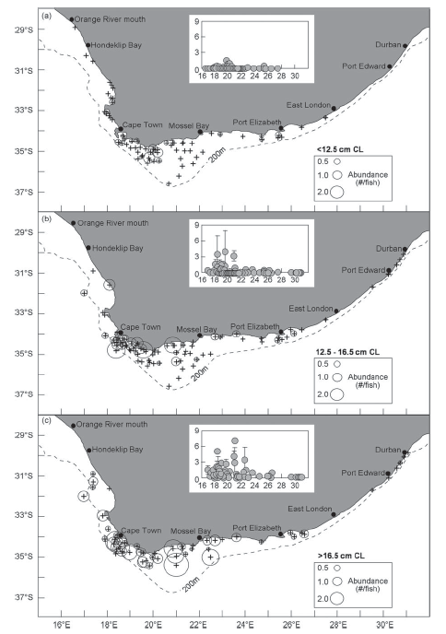
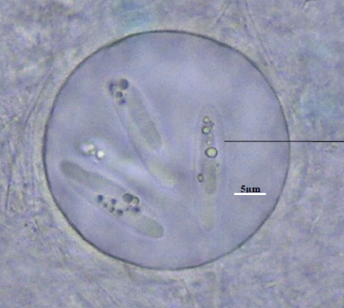
Application to SA sardine – research survey samples (ii):
Mean TTM abundance shows clear spatial pattern, declining from west to south and east
Highest adult infection on Central Agulhas Bank but parasite endemic area hypothesized to be west of Cape Agulhas (movement?)
Coccidian Eimeria sardinae (fish-to-fish transmission during spawning) found in the testes of western and southern but not eastern fish
van der Lingen et al (2015)

Slide 10
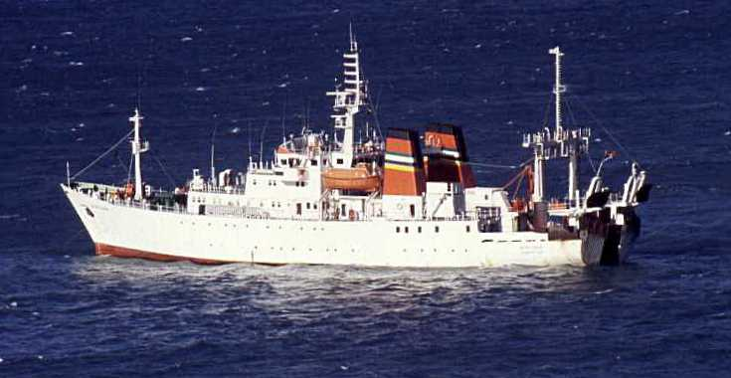
Application to SA sardine – research survey samples (iii):
Now 2 851 and 1 937 juvenile and adult western and southern sardine from Pelagic Biomass (PB: spring) and Pelagic Recruit (PR; autumn) surveys 2010-2014; unbalanced coverage between years, surveys, and stocks
Also more (ca 400) Eastern sardine examined

Slide 11
Application to SA sardine – research survey samples (iv):
Spatial distribution of TTM prevalence of infection, PBS 2010-2014 and composite

Slide 12
Application to SA sardine –research survey samples (v):
Pelagic Biomass Surveys (PSB): PREVALENCE-AT-LENGTH by year and average prevalence-at-length (standard errors); plus zoom

Slide 13
Application to SA sardine – research survey samples (vi):
Pelagic Biomass Surveys (PSB): ABUNDANCE-AT-LENGTH by year and average prevalence-at-length (standard errors); plus zoom

Slide 14
Application to SA sardine – research survey samples (vii):
Pelagic Recruit Surveys (PRS) 2010-2014: Composite length frequency distribution, prevalence- and abundance-at length (standard errors) for western and southern sardine

Slide 15

PB SURVEY
2010
FISHERY
No samples collected

Slide 16
PB SURVEY
2011
FISHERY

Slide 17
PB SURVEY
2012
FISHERY

Slide 18
PB SURVEY
2013
FISHERY

Slide 19
PB SURVEY
2014
FISHERY

Slide 20
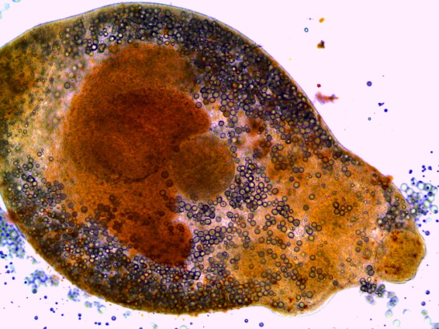
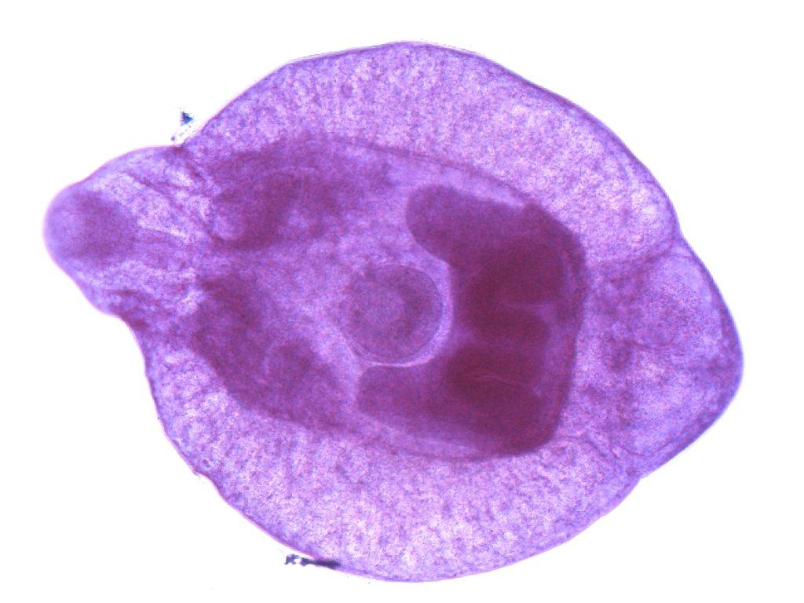
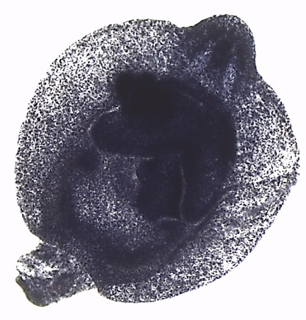
On-going and future work:
Sampling and processing of sardine from 2015 commercial and survey samples
Morphological and genetic descriptors of TTM to aid definitive identification
Definitive identification of 1st intermediate host and endemic area

